Slide 1
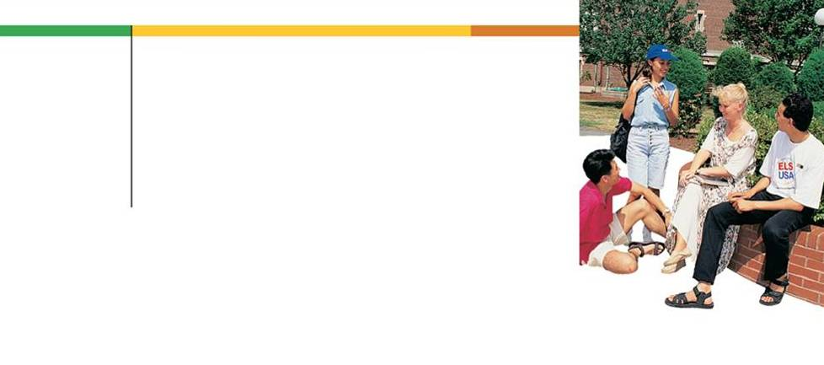
Section
3.4
Measures of Variation

Slide 2
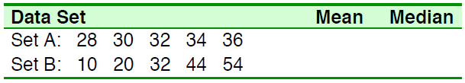
Measures of Variation
Compute the mean and the median for the following two
sets of data.
Measures of central tendency try to get a measure of all the data
into a single number, the central value (mean, median, mode),
without regard for how spread-out the data is.
To more completely describe sets of data we need a numerical
measure of how spread-out data is - these measures are called
measures of dispersion (or variance).
32
32 32

Slide 3

Measures of Variation
The range measures the spread of the data. The range is larger when the data values are more spread out from the mean.
Example 1 – Range
Consider the data set, find the range.
85, 100, 97, 84, 73, 89, 73, 65, 50, 83, 79, 92, 78, 10
Solution:
Range = Largest value – Smallest value
Range = 100 – 10 = 90

Slide 4
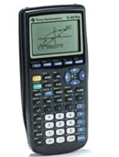
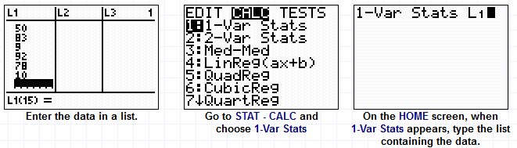
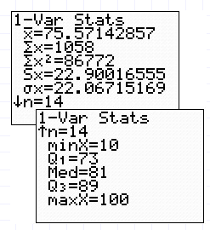
Example: Find the Range
Press STAT – 1: Edit – ENTER
(1)
(2)
(3)
(4)Hit ENTER.
When the 1-Var Stats information appears, notice that there is an arrow pointing downward at the bottom of the screen. Arrow down.
(5)Then Range = maxX – minX
= 100 – 10 = 90

Slide 5
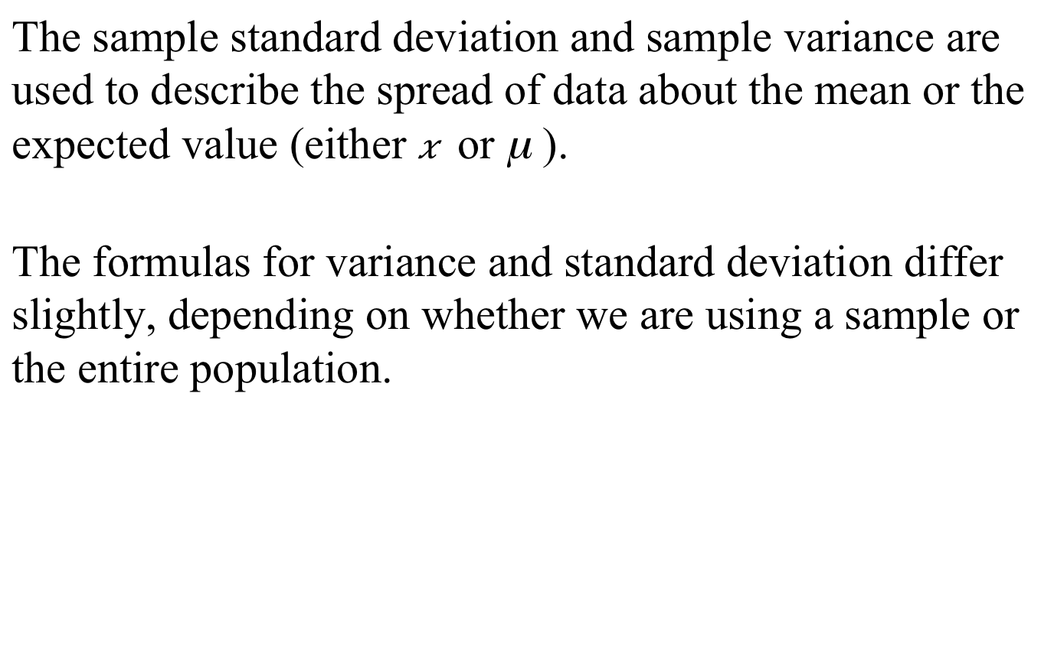
Variance and Standard Deviation
The sample standard deviation and sample variance are used to describe the spread of data about the mean or the expected value (either $\overline{x}$ or μ ).
The formulas for variance and standard deviation differ slightly, depending on whether we are using a sample or the entire population.

Slide 6
Variance and Standard Deviation
The variance is a measure of how far each value in the
data set is from the mean. Here is how it is defined:
1). Subtract the mean from each value in the data. This gives you a measure of the distance of each value from the mean.
2). Square each of these distances (so that they are all positive values), and add all of the squares together.
3). Divide the sum of the squares by the number of values in the data set or the number of values minus 1.
The standard deviation is simply the (positive) square root
of the variance.

Slide 7
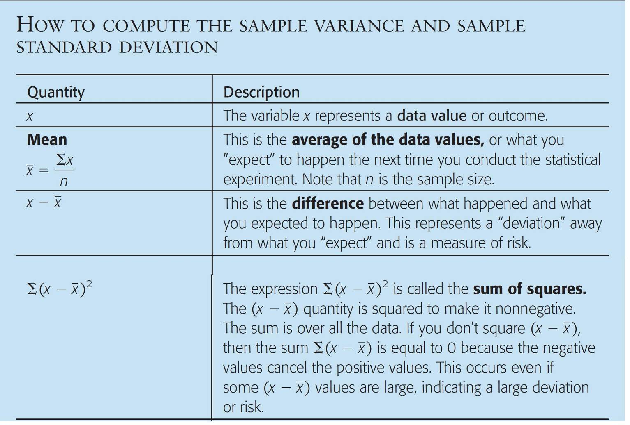
Sample Variance and Sample Standard Deviation
Procedure:

Slide 8
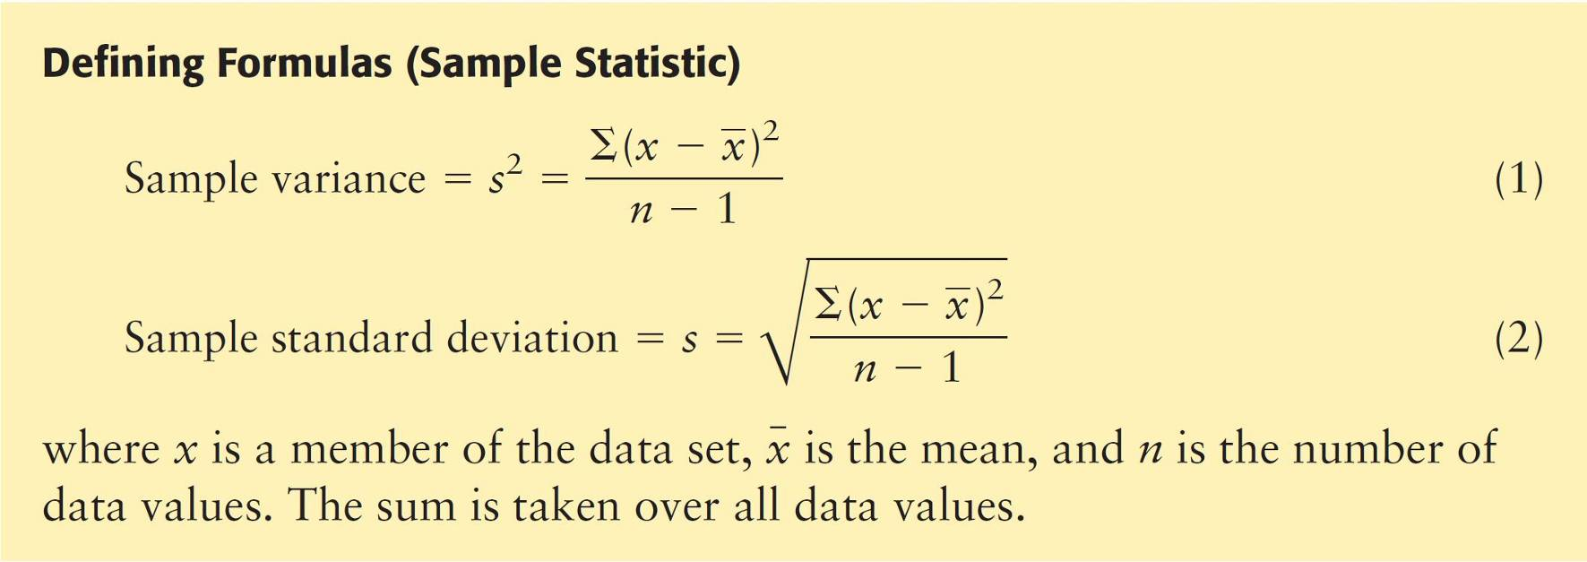
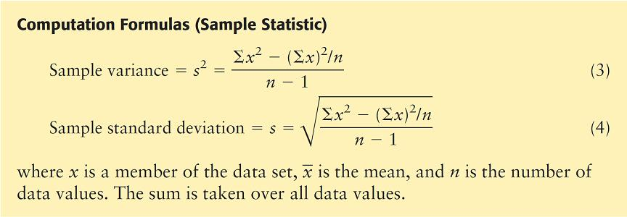
Sample Variance and Sample Standard Deviation

Slide 9
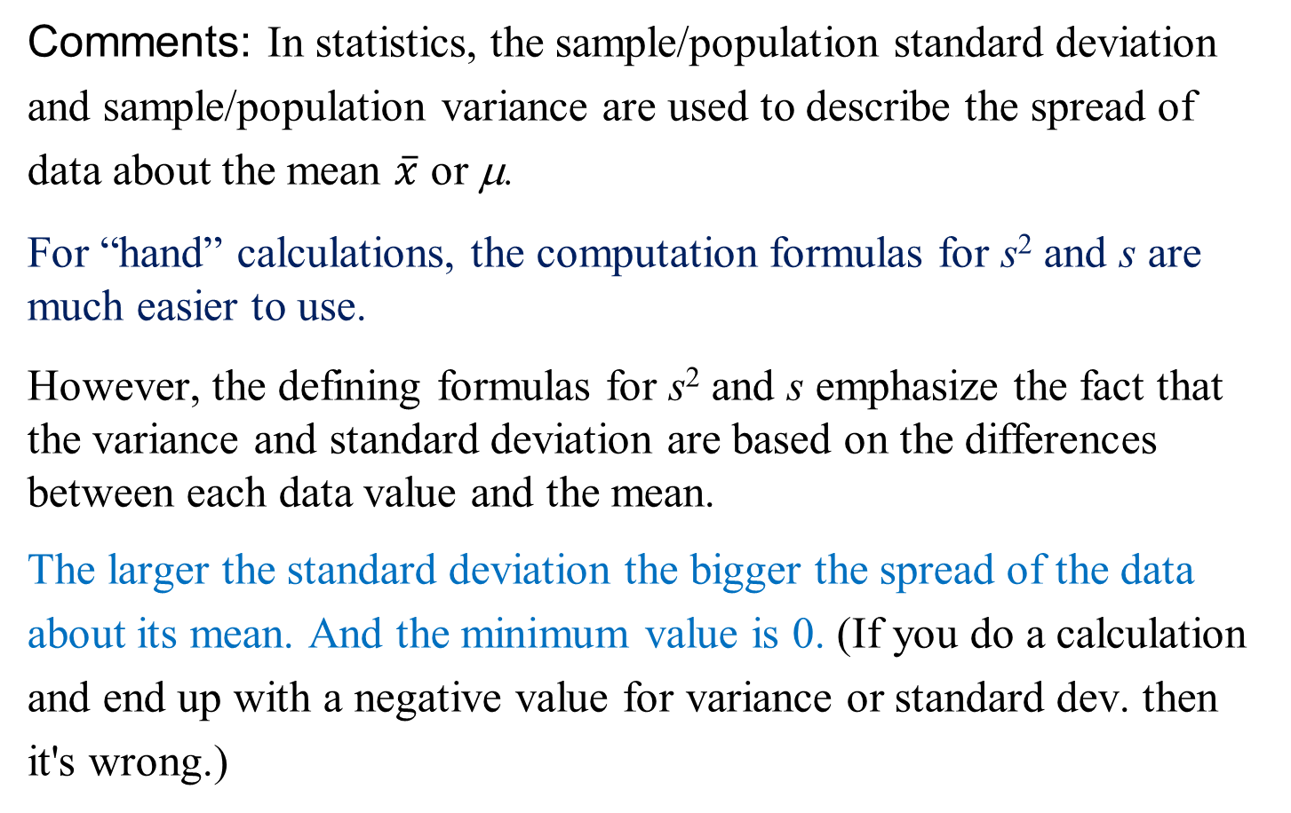
Sample Variance and Sample Standard Deviation
Comments: In statistics, the sample/population standard deviation
and sample/population variance are used to describe the spread of
data about the mean $\overline{x}$ or μ.
For “hand” calculations, the computation formulas for s² and s are much easier to use.
However, the defining formulas for s² and s emphasize the fact that the variance and standard deviation are based on the differences between each data value and the mean.
The larger the standard deviation the bigger the spread of the data
about its mean. And the minimum value is 0. (If you do a calculation
and end up with a negative value for variance or standard dev. then
it's wrong.)

Slide 10
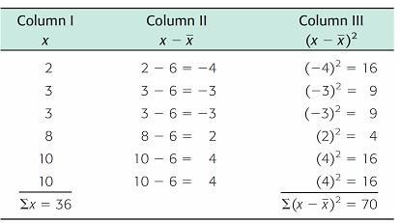


Example 2 – Sample Standard Deviation
Consider the data set, use the defining formula to find the sample variance and standard deviation.
2 3 3 8 10 10
Solution:
data value x
x – $\overline{x}$ = x – 6
(x – $\overline{x})2$
Sum of squares
To get the sample variance, divide the sum of the last column by n – 1. Since n = 6, n – 1 = 5.

Slide 11
Example – Solution
cont’d
Now obtain the sample standard deviation by taking the square root of the variance.

Slide 12
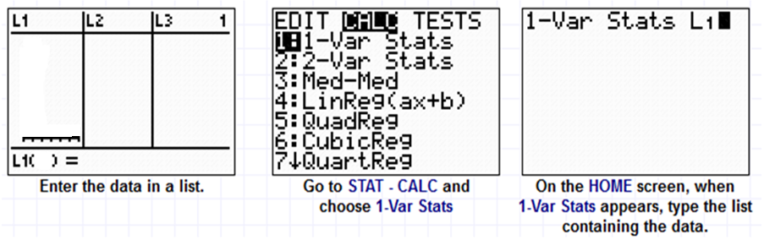
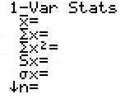
Example 2: Find the sample variance and sample standard deviation
2
3
3
8
10
10
7
(1)
(2)
(3)
(4)Hit ENTER.
When the 1-Var Stats information appears, Sx ≈ 3.74.
Find the variance by squaring the standard deviations.
S² = (3.74)² = 14.
6
Sample standard deviation
36
286
3.741657387
3.415650255
6
Population standard deviation

Slide 13
Practice Problem #1:
Data of height and weight of 6 students are given as follows:
Height (cm): 172 168 164 170 176 192
Weight(kg)：62 57 58 64 64 73
Find the mean, range, sample standard deviation, and
sample variance of each data set.
Mean range s s²
Height 173.67 28 9.83 9.83² = 96.63
Weight 63 16 5.73 5.73² = 32.83

Slide 14
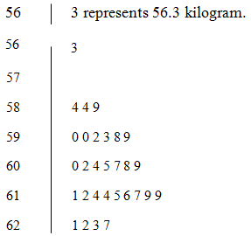
Example 3 Find the mean, median and range of the data in the stem-and-leaf diagram below.
Solution: From before, these data are as follows
56.3, 58.4, 58.4, 58.9, 59, 59, 59.2, 59.3, 59.8, 59.9, 60, 60.2, 60.4, 60.5, 60.7, 60.8, 60.9, 61.1, 61.2, 61.4, 61.4, 61.5, 61.6, 61.7, 61.9, 61.9, 62.1, 62.2, 62.3, 62.7

Slide 15
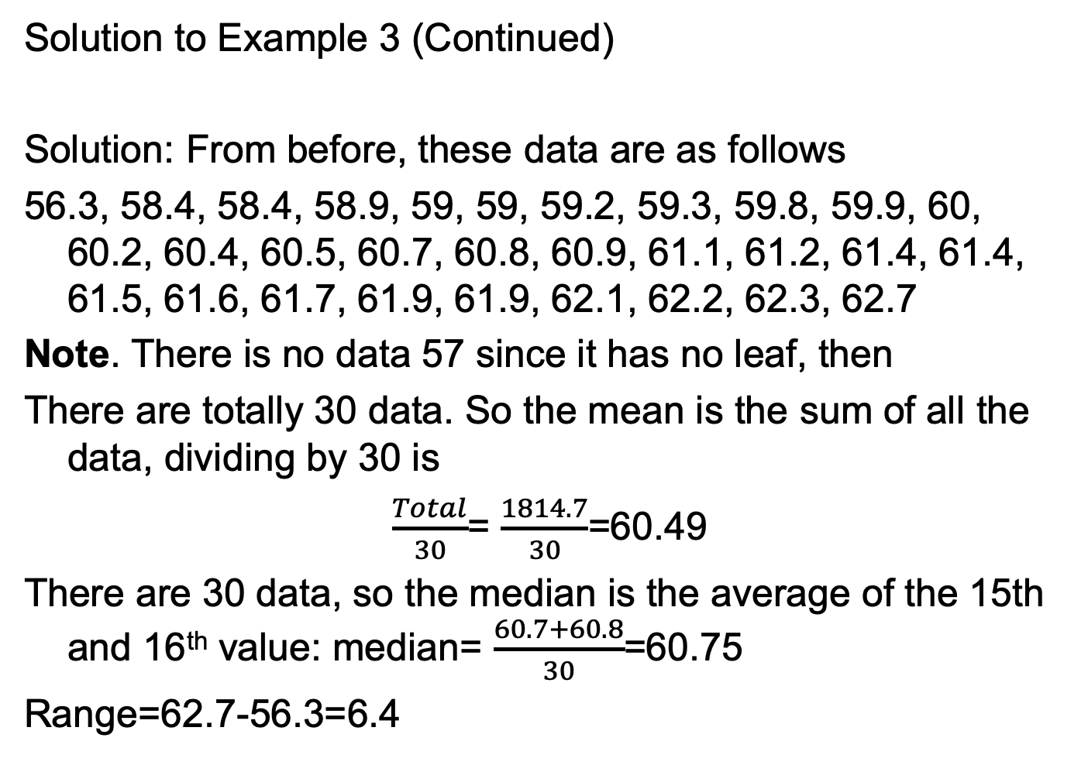
Solution to Example 3 (Continued)
Solution: From before, these data are as follows
56.3, 58.4, 58.4, 58.9, 59, 59, 59.2, 59.3, 59.8, 59.9, 60, 60.2, 60.4, 60.5, 60.7, 60.8, 60.9, 61.1, 61.2, 61.4, 61.4, 61.5, 61.6, 61.7, 61.9, 61.9, 62.1, 62.2, 62.3, 62.7
Note. There is no data 57 since it has no leaf, then
There are totally 30 data. So the mean is the sum of all the data, dividing by 30 is
$\frac{Total}{30}$= $\frac{1814.7}{30}$=60.49
There are 30 data, so the median is the average of the 15th and 16th value: median= $\frac{60.7+60.8}{30}$=60.75
Range=62.7-56.3=6.4

